Slide 1
The Network Layer
Prepared by
Risala Tasin Khan
Professor
IIT, JU

Slide 2

















Network layer
transport segment from sending to receiving host
on sending side encapsulates segments into datagrams
on receiving side, delivers segments to transport layer
router examines header fields in all IP datagrams passing through it
application
transport
network
data link
physical
network
data link
physical
network
data link
physical
network
data link
physical
network
data link
physical
network
data link
physical
network
data link
physical
network
data link
physical
network
data link
physical
network
data link
physical
application
transport
network
data link
physical
network
data link
physical
network
data link
physical

Slide 3
Two key network-layer functions
analogy:
routing: refers to the network-wide process that determines the end-to-end paths that packets take from source to destination
forwarding: refers to the router-local action of transferring a packet from an input link interface to the appropriate output link interface.
forwarding: move packets from one router’s input to appropriate router output
routing: determine route taken by packets from source to destination.
routing algorithms

Slide 4
Interplay between routing and forwarding
routing algorithm
routing algorithm determines
end-end-path through network
local forwarding table
forwarding table determines
local forwarding at this router
header value
output link
0100
0101
0111
1001
3
2
2
1
value in arriving
packet’s header
0111
1
3
2

Slide 5
Network Service Models
The network service model defines the characteristics of end-to-end transport of packets between sending and receiving end systems.
In the sending host, when the transport layer passes a packet to the network layer, specific services that could be provided by the network layer include:
• Guaranteed delivery: This service guarantees that the packet will eventually arrive at its destination.
• Guaranteed delivery with bounded delay: This service not only guarantees delivery of the packet, but delivery within a specified host-to-host delay bound (for example, within 100 msec).

Slide 6
Cont…
Furthermore, the following services could be provided to a flow of packets between a given source and destination:
• In-order packet delivery: This service guarantees that packets arrive at the destination in the order that they were sent.
• Guaranteed minimal bandwidth: This network-layer service emulates the behavior of a transmission link of a specified bit rate (for example, 1 Mbps) between sending and receiving hosts. As long as the sending host transmits bits (as part of packets) at a rate below the specified bit rate, then no packet is lost and each packet arrives within a prespecified host-to-host delay (for example, within 40 msec).
• Guaranteed maximum jitter: This service guarantees that the amount of time between the transmission of two successive packets at the sender is equal to the amount of time between their receipt at the destination
• Security services: Using a secret session key known only by a source and destination host, the network layer in the source host could encrypt the payloads of all datagrams being sent to the destination host. The network layer in the destination host would then be responsible for decrypting the payloads. With such a service, confidentiality would be provided to all transport-layer segments (TCP and UDP) between the source and destination hosts. In addition to confidentiality, the network layer could provide data integrity and source authentication services.

Slide 7
Internet’s Service Model
The Internet’s network layer provides a single service, known as best-effort service which means no service at all.
With best-effort service, timing between packets is not guaranteed to be preserved, packets are not guaranteed to be received in the order in which they were sent, nor is the eventual delivery of transmitted packets guaranteed.
Given this definition, a network that delivered no packets to the destination would satisfy the definition of best-effort delivery service.

Slide 8
Connection, connection-less service
datagram network provides network-layer connectionless service
virtual-circuit network provides network-layer connection service
analogous to TCP/UDP connecton-oriented / connectionless transport-layer services, but:
service: host-to-host
no choice: network provides one or the other
implementation: in network core

Slide 9
Virtual circuits
“source-to-dest path behaves much like telephone circuit”
performance-wise
network actions along source-to-dest path
call setup, teardown for each call before data can flow
each packet carries VC identifier (not destination host address)
every router on source-dest path maintains “state” for each passing connection
link, router resources (bandwidth, buffers) may be allocated to VC (dedicated resources = predictable service)

Slide 10
VC implementation
a VC consists of:
path from source to destination
VC numbers, one number for each link along path
entries in forwarding tables in routers along path
packet belonging to VC carries VC number (rather than dest address)
VC number can be changed on each link.
new VC number comes from forwarding table

Slide 11

VC forwarding table
12
22
32
1
3
2
VC number
forwarding table in
northwest router:
interface
number
Incoming interface Incoming VC # Outgoing interface Outgoing VC #
1 12 3 22
2 63 1 18
3 7 2 17
1 97 3 87
… … … …
VC routers maintain connection state information!

Slide 12

Virtual circuits: signaling protocols
used to setup, maintain teardown VC
used in ATM, frame-relay, X.25
not used in today’s Internet
application
transport
network
data link
physical
application
transport
network
data link
physical
5. data flow begins
6. receive data
4. call connected
3. accept call
1. initiate call
2. incoming call

Slide 13
Datagram Networks
In a datagram network, each time an end system wants to send a packet, it stamps the packet with the address of the destination end system and then pops the packet into the network
As a packet is transmitted from source to destination, it passes through a series of routers.
Each of these routers uses the packet’s destination address to forward the packet.
Specifically, each router has a forwarding table that maps destination addresses to link interfaces; when a packet arrives at the router, the router uses the packet’s destination address to look up the appropriate output link interface in the forwarding table.
The router then intentionally forwards the packet to that output link interface.

Slide 14
Datagram networks
no call setup at network layer
routers: no state about end-to-end connections
no network-level concept of “connection”
packets forwarded using destination host address
application
transport
network
data link
physical
application
transport
network
data link
physical
1. send datagrams
2. receive datagrams

Slide 15
Datagram forwarding table
32bit IP addresses mean 4 billion IP addresses, so rather than list individual destination address
list range of addresses
(aggregate table entries)
routing algorithm
local forwarding table
dest address
output link
address-range 1
address-range 2
address-range 3
address-range 4
3
2
2
1
IP destination address in
arriving packet’s header
1
3
2

Slide 16
Datagram forwarding table
Destination Address Range
11001000 00010111 00010000 00000000
through
11001000 00010111 00010111 11111111
11001000 00010111 00011000 00000000
through
11001000 00010111 00011000 11111111
11001000 00010111 00011001 00000000
through
11001000 00010111 00011111 11111111
otherwise
Link Interface
0
1
2
3

Slide 17
Longest prefix matching
longest prefix matching
Clearly, it is not necessary to have 4 billion entries in the router’s forwarding table. We could, for example, have the following forwarding table with just four entries:
when looking for forwarding table entry for given destination address, use longest address prefix that matches destination address.
Destination Address Range
11001000 00010111 00010*** *********
11001000 00010111 00011000 *********
11001000 00010111 00011*** *********
otherwise
Link interface
0
1
2
3
examples:
DA: 11001000 00010111 00010110 10100001
which interface?
DA: 11001000 00010111 00011000 10101010
which interface?

Slide 18
The Internet Protocol (IP)

Slide 19
The Internet network layer
host, router network layer functions:
the Internet’s network layer has three major components.
1) The first component is the IP protocol
2) The second major
component is the routing component which determines the path a datagram follows from source to destination.
3) The final component of the network layer is a facility to report errors in datagrams and respond to requests for certain network-layer information (ICMP Protocol)
transport layer: TCP, UDP
routing protocols
path selection
RIP, OSPF, BGP
IP protocol
addressing conventions
datagram format
packet handling conventions
network
layer
forwarding
table
ICMP protocol
error reporting
router “signaling”
link layer
physical layer

Slide 20
IP datagram format
IP protocol version
number
32 bits
total datagram
length (bytes)
header length
(bytes)
head.
len
type of
service
ver
length
for
fragmentation/
reassembly
“type” of data
flgs
fragment
offset
16-bit identifier
max number
remaining hops
(decremented at
each router)
time to
live
upper
layer
header
checksum
32 bit source IP address
upper layer protocol
to deliver payload to
32 bit destination IP address
options (if any)
e.g. timestamp,
record route
taken, specify
list of routers
to visit.
data
(variable length,
typically a TCP
or UDP segment)
how much overhead?
20 bytes of TCP
20 bytes of IP
= 40 bytes + app layer overhead

Slide 21
IPv4 datagram format
Version number:
These 4 bits specify the IP protocol version of the datagram. By looking at the version number, the router can determine how to interpret the remainder of the IP datagram.
Header length:
Because an IPv4 datagram can contain a variable number of options (which are included in the IPv4 datagram header), these 4 bits are needed to determine where in the IP datagram the data actually begins.
Most IP datagrams do not contain options, so the typical IP datagram has a 20-byte header.
Type of service:
The type of service (TOS) bits were included in the IPv4 header to allow different types of IP datagrams (for example, datagrams particularly requiring low delay, high throughput, or reliability) to be distinguished from each other.
For example, it might be useful to distinguish real-time datagrams (such as those used by an IP telephony application) from non-real-time traffic (for example, FTP)

Slide 22
Cont….
Datagram length:
This is the total length of the IP datagram (header plus data), measured in bytes.
Since this field is 16 bits long, the theoretical maximum size of the IP datagram is 65,535 bytes. However, datagrams are rarely larger than 1,500 bytes
Identifier, flags, fragmentation offset:
These three fields have to do with so-called IP fragmentation
Interestingly, the new version of IP, IPv6, does not allow for fragmentation at routers.
• Time-to-live.
The time-to-live (TTL) field is included to ensure that datagrams do not circulate forever (due to, for example, a long-lived routing loop) in the network.
This field is decremented by one each time the datagram is processed by a router. If the TTL field reaches 0, the datagram must be dropped

Slide 23
Cont…
Protocol:
This field is used only when an IP datagram reaches its final destination.
The value of this field indicates the specific transport-layer protocol to which the data portion of this IP datagram should be passed.
For example, a value of 6 indicates that the data portion is passed to TCP, while a value of 17 indicates that the data is passed to UDP
The protocol number is the glue that binds the network and transport layers together, whereas the port number is the glue that binds the transport and application layers together.
Header checksum:
The header checksum aids a router in detecting bit errors in a received IP datagram.
The header checksum is computed by treating each 2 bytes in the header as a number and summing these numbers using 1s complement arithmetic.
the 1s complement of this sum, known as the Internet checksum, is stored in the checksum field.
A router computes the header checksum for each received IP datagram and detects an error condition if the checksum carried in the datagram header does not equal the computed checksum.
Routers typically discard datagrams for which an error has been detected.
Note that the checksum must be recomputed and stored again at each router, as the TTL field, and possibly the options field as well, may change.

Slide 24
Why does TCP/IP perform error checking at both the transport and network layers?
First, note that only the IP header is checksummed at the IP layer, while the TCP/UDP checksum is computed over the entire TCP/UDP segment.
Second, TCP/UDP and IP do not necessarily both have to belong to the same protocol stack. TCP can, in principle, run over a different protocol (for example, ATM) and IP can carry data that will not be passed to TCP/UDP

Slide 25
IPv4 datagram format(Cont…)
Source and destination IP addresses
When a source creates a datagram, it inserts its IP address into the source IP address field and inserts the address of the ultimate destination into the destination IP address field.
Often the source host determines the destination address via a DNS lookup
Options:
The options fields allow an IP header to be extended.
Header options were meant to be used rarely—hence the decision to save overhead by not including the information in options fields in every datagram header.
However, the mere existence of options does complicate matters—since datagram headers can be of variable length, one cannot determine a priori where the data field will start.
Also, since some datagrams may require options processing and others may not, the amount of time needed to process an IP datagram at a router can vary greatly.
Data (payload):
In most circumstances, the data field of the IP datagram contains the transport-layer segment (TCP or UDP) to be delivered to the destination.
However, the data field can carry other types of data, such as ICMP messages
Note that an IP datagram has a total of 20 bytes of header (assuming no options). If the datagram carries a TCP segment, then each (nonfragmented) datagram carries a total of 40 bytes of header (20 bytes of IP header plus 20 bytes of TCP header) along with the application-layer message.

Slide 26
IP Fragmentation & Reassembly
network links have MTU (max.transfer size) - largest possible link-level frame.
different link types, different MTUs
large IP datagram divided (“fragmented”) within net
one datagram becomes several datagrams
“reassembled” only at final destination
IP header bits used to identify, order related fragments
fragmentation:
in: one large datagram
out: 3 smaller datagrams
reassembly

Slide 27
IP Fragmentation & Reassembly
When a destination host receives a series of datagrams from the same source, it needs to determine whether any of these datagrams are fragments of some original, larger datagram.
If some datagrams are fragments, it must further determine when it has received the last fragment and how the fragments it has received should be pieced back together to form the original datagram.
To allow the destination host to perform these reassembly tasks, the designers of IP (version 4) put identification, flag, and fragmentation offset fields in the IP datagram header.
When a datagram is created, the sending host stamps the datagram with an identification number as well as source and destination addresses.
Typically, the sending host increments the identification number for each datagram it sends.
When a router needs to fragment a datagram, each resulting datagram (that is, fragment) is stamped with the source address, destination address, and identification number of the original datagram.
When the destination receives a series of datagrams from the same sending host, it can examine the identification numbers of the datagrams to determine which of the datagrams are actually fragments of the same larger datagram.
Because IP is an unreliable service, one or more of the fragments may never arrive at the destination. For this reason, in order for the destination host to be absolutely sure it has received the last fragment of the original datagram, the last fragment has a flag bit set to 0, whereas all the other fragments have this flag bit set to 1
Also, in order for the destination host to determine whether a fragment is missing the offset field is used to specify where the fragment fits within the original IP datagram.

Slide 28
IP Fragmentation and Reassembly
Example
4000 byte datagram ; i.e. 3980 data bytes
MTU = 1500 bytes
length
=4000
ID
=x
fragflag
=0
offset
=0
One large datagram becomes
several smaller datagrams
length
=1500
ID
=x
fragflag
=1
offset
=0
1480 bytes in data field
length
=1500
ID
=x
fragflag
=1
offset
=185
1480 +1480= 2960
3980-2960=1020
Offset=185=1480/8
length
=1040
ID
=x
fragflag
=0
offset
=370
Requirement: The amount of original payload data in all but the last fragment be a multiple of 8 bytes. The offset value be specified in units of 8-byte chunks
Offset=370=2960/8

Slide 29
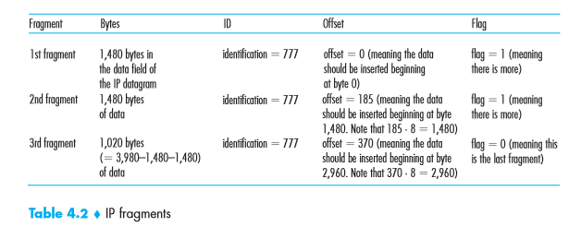
IP Datagram Fragmentation

Slide 30
IP Addressing
A host typically has only a single link into the network; when IP in the host wants to send a datagram, it does so over this link.
The boundary between the host and the physical link is called an interface.
Now consider a router and its interfaces. Because a router’s job is to receive a datagram on one link and forward the datagram on some other link, a router necessarily has two or more links to which it is connected. The boundary between the router and any one of its links is also called an interface.
A router thus has multiple interfaces, one for each of its links.
Because every host and router is capable of sending and receiving IP datagrams, IP requires each host and router interface to have its own IP address.
Thus, an IP address is technically associated with an interface, rather than with the host or router containing that interface.

Slide 31
IP Addressing (Cont….)
Each IP address is 32 bits long (equivalently, 4 bytes), and there are thus a total of 2³² possible IP addresses.
Thus there are about 4 billion possible IP addresses
These addresses are typically written in so-called dotted-decimal notation, in which each byte of the address is written in its decimal form and is separated by a period (dot) from other bytes in the address.
For example, consider the IP address 193.32.216.9.
The 193 is the decimal equivalent of the first 8 bits of the address; the 32 is the decimal equivalent of the second 8 bits of the address, and so on.
193.32.216.9 = 11000001 00100000 11011000 00001001
Each interface on every host and router in the global Internet must have an IP address that is globally unique
These addresses cannot be chosen in a willy-nilly manner, however.
A portion of an interface’s IP address will be determined by the subnet to which it is connected.

Slide 32
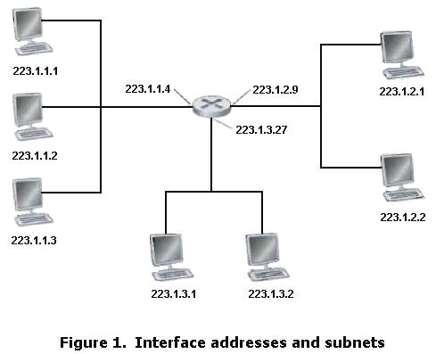
IP Addressing (Cont..)
In this figure, one router (with three interfaces) is used to interconnect seven hosts.
The three hosts in the upper-left portion of Figure 1, and the router interface to which they are connected, all have an IP address of the form 223.1.1.xxx.
That is, they all have the same leftmost 24 bits in their IP address.
The three interfaces(hosts) are also interconnected to each other by a network that contains no routers. This network could be interconnected by an Ethernet LAN, in which case the interfaces would be interconnected by an Ethernet switch or by a wireless access point
In IP terms, this network interconnecting three host interfaces and one router interface forms a subnet

Slide 33
Subnet Concept
A subnet is also called an IP network or simply a network in the Internet literature
IP addressing assigns an address to this subnet: 223.1.1.0/24, where the /24 notation, sometimes known as a subnet mask, indicates that the leftmost 24 bits of the 32-bit quantity define the subnet address.
The subnet 223.1.1.0/24 thus consists of the three host interfaces (223.1.1.1, 223.1.1.2, and 223.1.1.3) and one router interface (223.1.1.4).
Any additional hosts attached to the 223.1.1.0/24 subnet would be required to have an address of the form 223.1.1.xxx.
There are two additional subnets shown in Figure 4.15: the 223.1.2.0/24 network and the 223.1.3.0/24 subnet
223.1.1.0/24
223.1.2.0/24
223.1.3.0/24

Slide 34
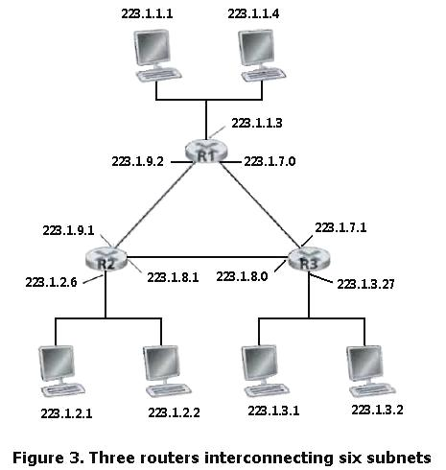
Figure 3 shows three routers that are interconnected with each other by point-to-point links. Each router has three interfaces, one for each point-to-point link and one for the broadcast link that directly connects the router to a pair of hosts.
Three subnets, 223.1.1.0/24, 223.1.2.0/24, and 223.1.3.0/24, are similar to the subnets we encountered in Figure 1 are found here.
But note that there are three additional subnets in this example as well: one subnet, 223.1.9.0/24, for the interfaces that connect routers R1 and R2; another subnet, 223.1.8.0/24, for the interfaces that connect routers R2 and R3; and a third subnet, 223.1.7.0/24, for the interfaces that connect routers R3 and R1.

Slide 35
IP addressing: CIDR
CIDR: Classless InterDomain Routing
subnet portion of address is of arbitrary length
address format: a.b.c.d/x, where x is # bits in subnet portion of address
In this case, the IP addresses of devices within the subnet will share the common prefix
subnet
part
host
part
11001000 00010111 00010000 00000000
200.23.16.0/23

Slide 36
Classful Addressing
Before CIDR was adopted, the network portions of an IP address were constrained to be 8, 16, or 24 bits in length, an addressing scheme known as classful addressing, since subnets with 8-, 16-, and 24-bit subnet addresses were known as class A, B, and C networks, respectively
The requirement that the subnet portion of an IP address be exactly 1, 2, or 3 bytes long turned out to be problematic for supporting the rapidly growing number of organizations with small and medium-sized subnets.
A class C (/24) subnet could accommodate only up to 2⁸ – 2 = 254 hosts (two of the 2⁸ = 256 addresses are reserved for special use)—too small for many organizations.
However, a class B (/16) subnet, which supports up to 65,634 hosts, was too large.
Under classful addressing, an organization with, say, 2,000 hosts was typically allocated a class B (/16) subnet address.
This led to a rapid depletion of the class B address space and poor utilization of the assigned address space.
For example, the organization that used a class B address for its 2,000 hosts was allocated enough of the address space for up to 65,534 interfaces—leaving more than 63,000 addresses that could not be used by other organizations.

Slide 37
Classful IP Addressing
In classful addressing the address space is
divided into 5 classes:
A, B, C, D, and E.

Slide 38
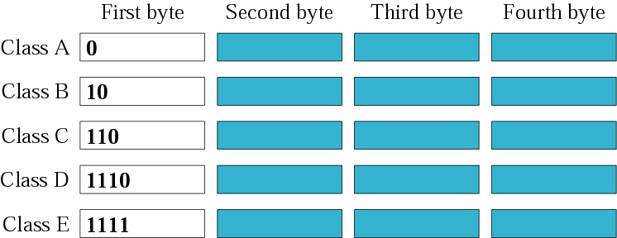
Figure 4-3
Finding the class in binary notation

Slide 39
Class A:
The first bit of the first octet is always set to 0 (zero). Thus the first octet ranges from 1 – 127
*0 and 127 are not used. (usable 1-126)
*The IP range 127.x.x.x is reserved for loopback IP addresses.
 | 128 | 64 | 32 | 16 | 8 | 4 | 2 | 1
Start | 0 | 0 | 0 | 0 | 0 | 0 | 0 | 0 | 0
End | 0 | 1 | 1 | 1 | 1 | 1 | 1 | 1 | 127

Slide 40
Class B:
The first two bits of the first octet is always fixed (10). Thus the first octet ranges from 128 – 191
*Class B IP Addresses range from 128.0.x.x to 191.255.x.x.
 | 128 | 64 | 32 | 16 | 8 | 4 | 2 | 1
Start | 1 | 0 | 0 | 0 | 0 | 0 | 0 | 0 | 128
End | 1 | 0 | 1 | 1 | 1 | 1 | 1 | 1 | 191

Slide 41
Class C:
The first three bits of the first octet is always fixed (110). Thus the first octet ranges from 192 – 223
*Class C IP addresses range from 192.0.0.x to 223.255.255.x.
 | 128 | 64 | 32 | 16 | 8 | 4 | 2 | 1
Start | 1 | 1 | 0 | 0 | 0 | 0 | 0 | 0 | 192
End | 1 | 1 | 0 | 1 | 1 | 1 | 1 | 1 | 223

Slide 42
Class D:
The first four bits of the first octet is always fixed (1110). Thus the first octet ranges from 224 – 239
*Class D has IP address rage from 224.0.0.0 to 239.255.255.255.
*Class D is reserved for Multicasting.
 | 128 | 64 | 32 | 16 | 8 | 4 | 2 | 1
Start | 1 | 1 | 1 | 0 | 0 | 0 | 0 | 0 | 224
End | 1 | 1 | 1 | 0 | 1 | 1 | 1 | 1 | 239

Slide 43
Class E:
This IP Class is reserved for experimental purposes only for Research & Development or Study. IP addresses in this class ranges from 240.0.0.0 to 255.255.255.254.

Slide 44
Obtaining a Block of Addresses
In order to obtain a block of IP addresses for use within an organization’s subnet, a network administrator might first contact its ISP, which would provide addresses from a larger block of addresses that had already been allocated to the ISP.
For example, the ISP may itself have been allocated the address block 200.23.16.0/20.
The ISP, in turn, could divide its address block into eight equal-sized contiguous address blocks and give one of these address blocks out to each of up to eight organizations that are supported by this ISP
ISP’s block
200.23.16.0/20 11001000 00010111 00010000 00000000
Organization 0 200.23.16.0/23 11001000 00010111 00010000 00000000
Organization 1 200.23.18.0/23 11001000 00010111 00010010 00000000
Organization 2 200.23.20.0/23 11001000 00010111 00010100 00000000
. . . . . . . . .
Organization 7 200.23.30.0/23 11001000 00010111 00011110 00000000

Slide 45
Obtaining a Host Address: the Dynamic Host Configuration Protocol
Once an organization has obtained a block of addresses, it can assign individual IP addresses to the host and router interfaces in its organization.
A system administrator will typically manually configure the IP addresses into the router (often remotely, with a network management tool).
Host addresses can also be configured manually, but more often this task is now done using the Dynamic Host Configuration Protocol (DHCP)
DHCP allows a host to obtain (be allocated) an IP address automatically.
A network administrator can configure DHCP so that a given host receives the same IP address each time it connects to the network, or a host may be assigned a temporary IP address that will be different each time the host connects to the network
In addition to host IP address assignment, DHCP also allows a host to learn additional information, such as its subnet mask, the address of its first-hop router (often called the default gateway), and the address of its local DNS server.
Because of DHCP’s ability to automate the network-related aspects of connecting a host into a network, it is often referred to as a plug-and-play protocol

Slide 46
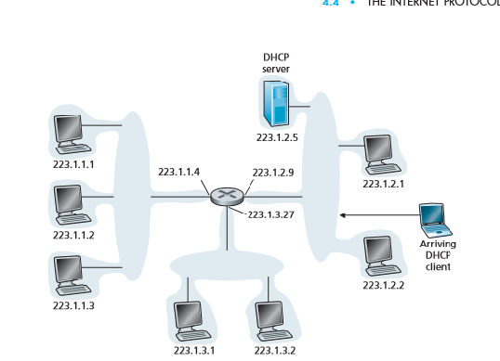
DHCP Protocol
DHCP is a client-server protocol.
A client is typically a newly arriving host wanting to obtain network configuration information, including an IP address for itself.
In the simplest case, each subnet will have a DHCP server.
If no server is present on the subnet, a DHCP relay agent (typically a router) that knows the address of a DHCP server for that network is needed.
Figure 1 shows a DHCP server attached to subnet 223.1.2.5/24, with the router serving as the relay agent for arriving clients attached to subnets 223.1.1.4/24 and 223.1.3.27/24.

Slide 47
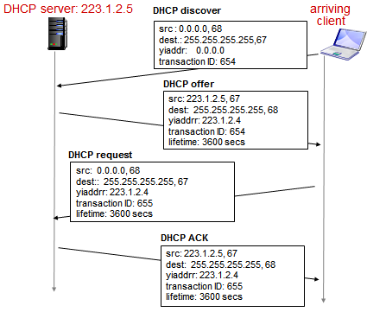
DHCP (Cont…)
For a newly arriving host, the DHCP protocol is a four-step process.
In this figure, yiaddr (as in “your Internet address”) indicates the address being allocated to the newly arriving client. The four steps are:
DHCP server discovery:
The first task of a newly arriving host is to find a DHCP server with which to interact.
This is done using a DHCP discover message, which a client sends within a UDP packet to port 67.
The UDP packet is encapsulated in an IP datagram.
The DHCP client creates an IP datagram containing its DHCP discover message along with the broadcast destination IP address of 255.255.255.255 and a “this host” source IP address of 0.0.0.0.
The DHCP client passes the IP datagram to the link layer, which then broadcasts this frame to all nodes attached to the subnet

Slide 48
DHCP server offer(s):
A DHCP server receiving a DHCP discover message responds to the client with a DHCP offer message that is broadcast to all nodes on the subnet, again using the IP broadcast address of 255.255.255.255.
why this server reply must also be broadcast?
Since several DHCP servers can be present on the subnet, the client may find itself in the enviable position of being able to choose from among several offers.
Each server offer message contains the transaction ID of the received discover message, the proposed IP address for the client, the network mask, and an IP address lease time—the amount of time for which the IP address will be valid.

Slide 49
DHCP request:
The newly arriving client will choose from among one or more server offers and respond to its selected offer with a DHCP request message, echoing back the configuration parameters.
• DHCP ACK:
The server responds to the DHCP request message with a DHCP ACK message, confirming the requested parameters.

Slide 50
NAT: network address translation
rest of
Internet
local network
(e.g., home network)
10.0.0/24
10.0.0.1
10.0.0.4
10.0.0.2
138.76.29.7
10.0.0.3
all datagrams leaving local
network have same single source NAT IP address: 138.76.29.7,different source port numbers
datagrams with source or
destination in this network
have 10.0.0/24 address for
source, destination (as usual)

Slide 51
NAT: network address translation
motivation: local network uses just one IP address as far as outside world is concerned:
range of addresses not needed from ISP: just one IP address for all devices
can change addresses of devices in local network without notifying outside world
can change ISP without changing addresses of devices in local network
devices inside local net not explicitly addressable, visible by outside world (a security plus)

Slide 52
NAT: network address translation
implementation: NAT router must:
outgoing datagrams: replace (source IP address, port #) of every outgoing datagram to (NAT IP address, new port #)
. . . remote clients/servers will respond using (NAT IP address, new port #) as destination addr
remember (in NAT translation table) every (source IP address, port #) to (NAT IP address, new port #) translation pair
incoming datagrams: replace (NAT IP address, new port #) in dest fields of every incoming datagram with corresponding (source IP address, port #) stored in NAT table

Slide 53
NAT: network address translation
NAT translation table
WAN side addr LAN side addr
2: NAT router
changes datagram
source addr from
10.0.0.1, 3345 to
138.76.29.7, 5001,
updates table
1: host 10.0.0.1
sends datagram to
128.119.40.186, 80
138.76.29.7, 5001 10.0.0.1, 3345
…… ……
S: 10.0.0.1, 3345
D: 128.119.40.186, 80
10.0.0.1
1
2
S: 138.76.29.7, 5001
D: 128.119.40.186, 80
10.0.0.4
10.0.0.2
138.76.29.7
S: 128.119.40.186, 80
D: 10.0.0.1, 3345
4
S: 128.119.40.186, 80
D: 138.76.29.7, 5001
3
10.0.0.3
4: NAT router
changes datagram
dest addr from
138.76.29.7, 5001 to 10.0.0.1, 3345
3: reply arrives
dest. address:
138.76.29.7, 5001

Slide 54
Internet Control Message Protocol (ICMP)
ICMP is used by hosts and routers to communicate network-layer information to each other.
The most typical use of ICMP is for error reporting.
For example, when running a Telnet, FTP, or HTTP session, you may have encountered an error message such as “Destination network unreachable.”
This message had its origins in ICMP.
At some point, an IP router was unable to find a path to the host specified in your Telnet, FTP, or HTTP application.
That router created and sent a type-3 ICMP message to your host indicating the error.

Slide 55
ICMP (Cont….)
ICMP is often considered part of IP but architecturally it lies just above IP, as ICMP messages are carried inside IP datagrams.
That is, ICMP messages are carried as IP payload, just as TCP or UDP segments are carried as IP payload.
ICMP messages have a type field, a code field and checksum
Type field will say what type of error has been occurred and code field is the sub part of the type field.
ICMP message is always sent back to the sender

Slide 56
ICMP (Cont…)
Error Reporting
Destination Unreachable
Source Quench
Time Exceeded
Parameter
Problems
Redirection

